Slide 1

QUTRIT INNOVATIONS
Cascade Communication for IoT
Innovative IoT Gateway - LinxLink

Slide 2





Vision & Mission
Vision
Mission
Making massive-scale IoT simple, secure, and affordable through local-first, hierarchical networking.
Deliver an intelligent gateway platform for significant cost reduction (45% setup, 90% bandwidth) and scalable device management.
IoT device proliferation:
from 21.1B (2025) to 39B (2030).
Enhanced local processing with Edge AI and 5G integration.
Local optimization critical to counter rising cloud/bandwidth costs.

Slide 3


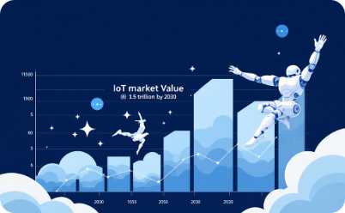
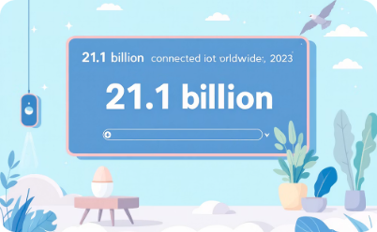

IoT Market Growth & Future Outlook
The Internet of Things (IoT) market is set for exponential growth, driven by innovation and increasing demand for connected solutions. This card explores the landscape, key drivers, and immense opportunities within the IoT revolution.
$300B
Current Market Size (2023)
Estimated global IoT
market value.
$1.5T
Market Size (2030)
Anticipated market value,
reflecting exponential growth.
21.1B
Connected Devices (2023)
Active IoT devices
currently deployed worldwide.
39B
Connected Devices (2030)
Projected IoT devices,
signifying widespread adoption.

Slide 4

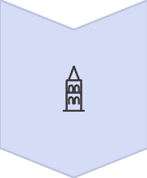



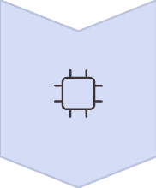



Key Growth Drivers
Market Opportunities
5G Connectivity
Smart Manufacturing
High bandwidth and ultra-low latency for real-time data and enhanced communication.
Predictive maintenance, automated quality, supply chain optimization.
Edge Computing
Healthcare
Local data processing, reducing latency and bandwidth, boosting security.
Remote monitoring, smart hospitals, wearable trackers.
AI Integration
Smart Cities
Intelligent IoT for predictive analytics, automation, and autonomous decisions.
Intelligent traffic, public safety, environmental monitoring.
Edge-First Architectures
Retail
Prioritizing local processing for optimal performance and cost in distributed IoT.
Inventory, personalized shopping, smart stores.

Slide 5
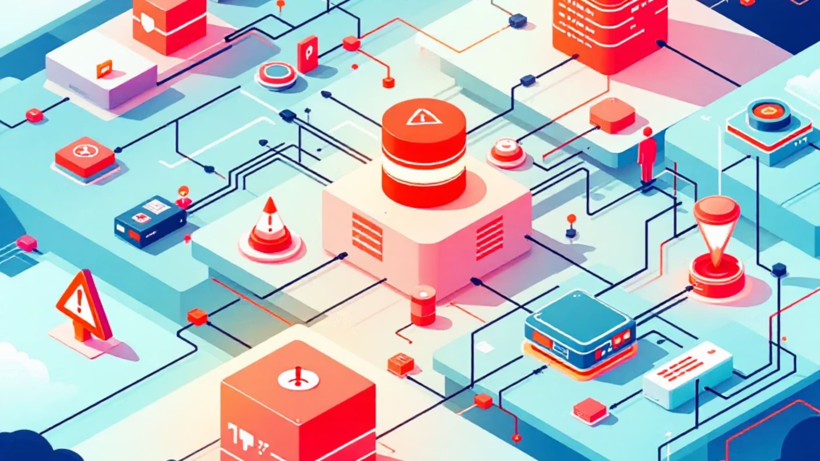
The Problem — IoT Deployment Pain
Enterprise IoT deployments face critical challenges that limit scalability, increase costs, and create operational complexity. Current solutions force organizations into cloud dependency, expensive bandwidth consumption, and fragmented security models.
Data Chaos
Network Dependency
Data management chaos and siloed telemetry create integration nightmares across device fleets
Connectivity dependence on cloud/wide-area networks creates single points of failure
High Cost
Security Risk
High bandwidth and cloud bills drain operational budgets with every data transmission
Security vulnerabilities across device fleets expose critical infrastructure to threats
Time & Complexity
Vendor Lock-in
Slow, complex implementations with limited scalability delay time-to-value
Vendor lock-in and lack of interoperability trap organizations in proprietary ecosystems

Slide 6

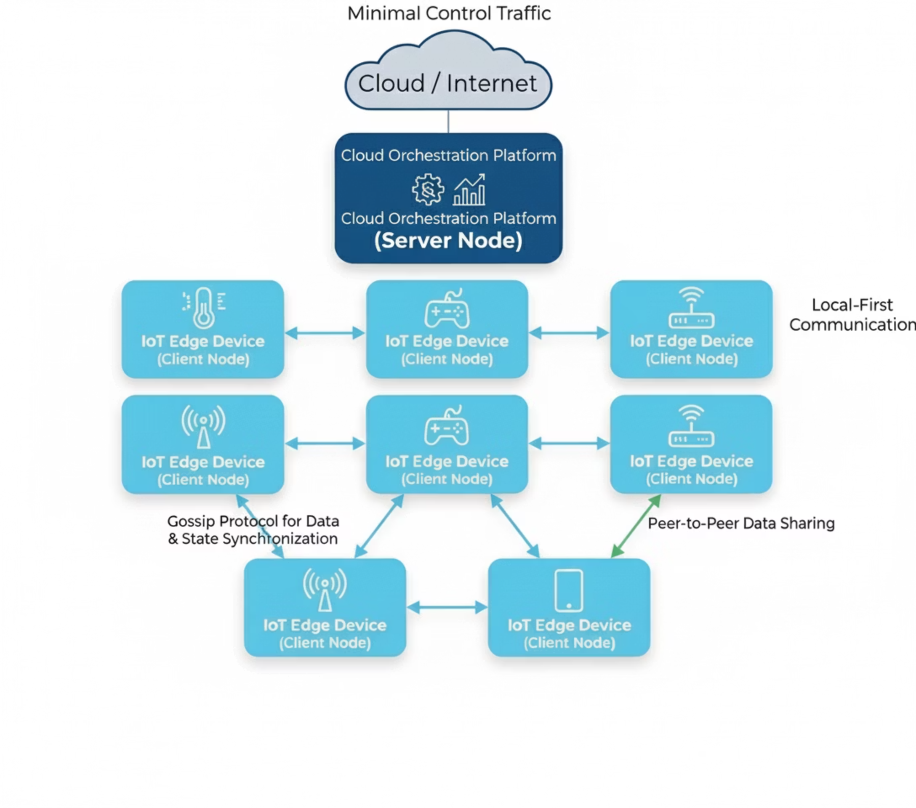




Qutrit Solution & Key Innovation
The Cascade Architecture revolutionizes IoT networking through intelligent hierarchical design and local-first communication.
Server Node
Orchestrates analytics, OTA updates, backups & coordination between clusters
Client Nodes
Sensors/actuators with pub/sub capability; operate even with intermittent internet
Edge Intelligence
Real-time analytics, self-healing mesh robust in lossy RF environments
Key Benefits
Orders-of-magnitude fewer cloud calls
Self-healing network even during connectivity loss
Edge filtering/aggregation lowers storage costs
80% bandwidth savings

Slide 7




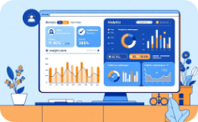
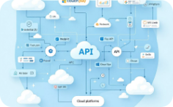
Product Platform —
Low-Code Management
Qutrit's platform enables IT and SIs to deploy and operate complex IoT networks with intuitive, low-code automation and enterprise-grade monitoring.
Node Configuration
Schedule Management
Intelligent Alerts
Intuitive visual design for device provisioning.
Drag-and-drop automation for device operations.
Configurable triggers and multi-channel notifications.
Health Monitoring
APIs & Integrations
Real-time status and predictive analytics prevent downtime.
RESTful APIs and pre-built connectors for all systems.

Slide 8

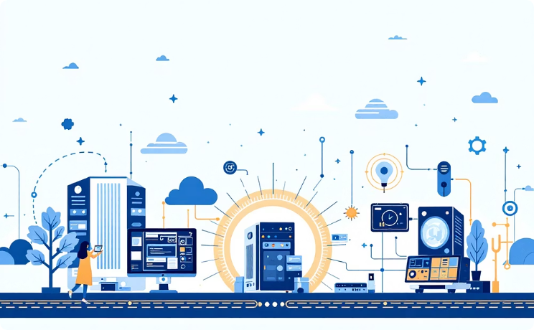

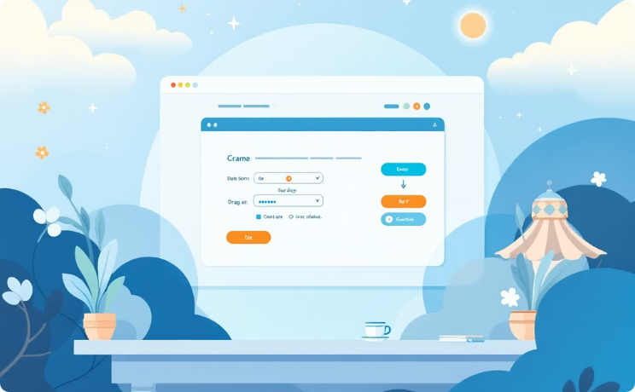
Competitive Edge & Market Differentiators
Our competitive edge is built on three patent-pending innovations:
Edge-Centric Architecture
WiFi Range Extension
Low-Code Deployment
Localized data processing at the source reduces latency and eliminates cloud fees.
Proprietary antenna design extends WiFi range by 200-300% without repeaters
Web-based tools enable non-technical users to deploy and manage IoT networks.
Market Differentiators:
45%
90%
75%
99.9%
Setup Cost Reduction
Bandwidth Savings
Faster Implementations
Security Uptime
Simplified deployment and configuration drastically reduces implementation expenses
Local-first architecture eliminates unnecessary cloud traffic and data transmission costs
Low-code platform and pre-built integrations accelerate time-to-production
Distributed architecture with local authentication ensures continuous

Slide 9

Market Applications & Use Cases
Qutrit's cascade architecture serves diverse IoT verticals with proven use cases across residential, industrial, and infrastructure deployments. Our platform adapts to varied requirements while delivering consistent cost and performance advantages.
Home/Smart Buildings
Industrial IoT
Infrastructure/Smart City
$64.1B (2024) → $101B (2030)
Strong growth forecast (2025-2030)
Emerging high-growth segment
Lighting, HVAC, metering
Equipment monitoring
Traffic management
Cost-efficient control
Predictive maintenance
Environmental sensing
Smart home automation
Production optimization
Utilities optimization
Energy optimization
Environmental controls
Emergency coordination
Note: Smart Buildings market data from Memoori research (baseline scenario, 2024-2030)

Slide 10


Industrial IoT Case Study: Predictive Maintenance
A large manufacturing facility with 100 machines needs to monitor 1,000 analog parameters (10 each machine) every minute for effective predictive maintenance. Let’s Consider each machine has 10K data to be collected. Following is the comparison of traditional IoT implementation Vs. Qutrit IoT implementation.
Feature | Traditional IoT | Qutrit IoT
Device Architecture | 100 edge devices | 10 server nodes + 90 client nodes
Data Processing | Cloud-based | Local processing by server node
Bandwidth Usage | High (cloud transmission) | Low (local processing)
Latency | Higher | Lower
Design | All-in-one gateway | Modular, scalable
IoT unit | Teltonika – TRB246 (₹ 19,900) or Tor Jupitor - (₹ 28,000) | Server node - ₹ 18,000 & Client node - ₹ 10,000
Server Requirement | 2 vCPUs, 2 GB memory (with load balancer) | 0.2 vCPU / 128 MB memory
₹19.9L
₹10.8L
₹2260/-
₹362/-
Traditional Setup
Qutrit Setup
Traditional – IoT
Qutrit – IoT
Initial investment using Teltonika TRB246 units
45% cost reduction with modular architecture
Monthly Server cost (including load balancer)
Monthly Server Cost (No load balancer required)

Slide 11

Business Model & Pricing
Qutrit employs a dual-revenue model, strategically designed to capture value across both B2B and B2C segments. This approach allows for diversified market penetration and stable growth, with a clear 70/30 split.
B2B IoT Implementations (70% Revenue)
B2C DIY Devices (30% Revenue)
Custom Solutions: Tailored IoT deployments for manufacturing, agriculture, and infrastructure.
Smart Home Kits: Pre-configured IoT bundles for security, energy management, and automation.
Subscription Model: Optional SaaS for advanced analytics and remote monitoring.
Developer Kits: Accessible kits for hobbyists and startups, fostering innovation in custom IoT projects.
Licensing: Patent licensing for antenna and edge-processing technology to OEMs.

Slide 12

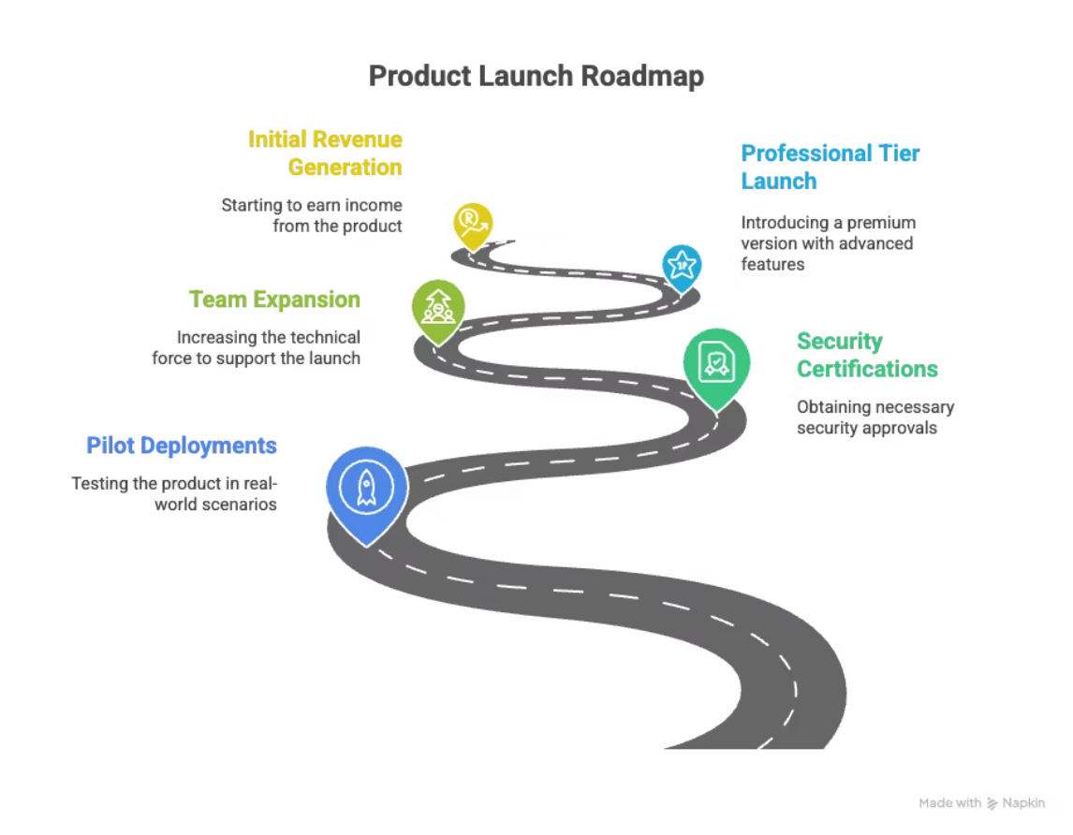
Investment Ask & Use of Funds
We are raising Rs. 20,00,000/- to accelerate product development, launch pilot programs, and drive commercialization. This seed funding will establish market presence and validate our technology with initial customers across target verticals.
Description | Required Funds
Core development - Research and Engineering (MVP Stage) | ₹6,00,000
Team Building | ₹8,00,000
General Expenses | ₹3,00,000
Operations & Working Capital | ₹3,00,000
Total (Rs.) : | ₹20,00,000

Slide 13
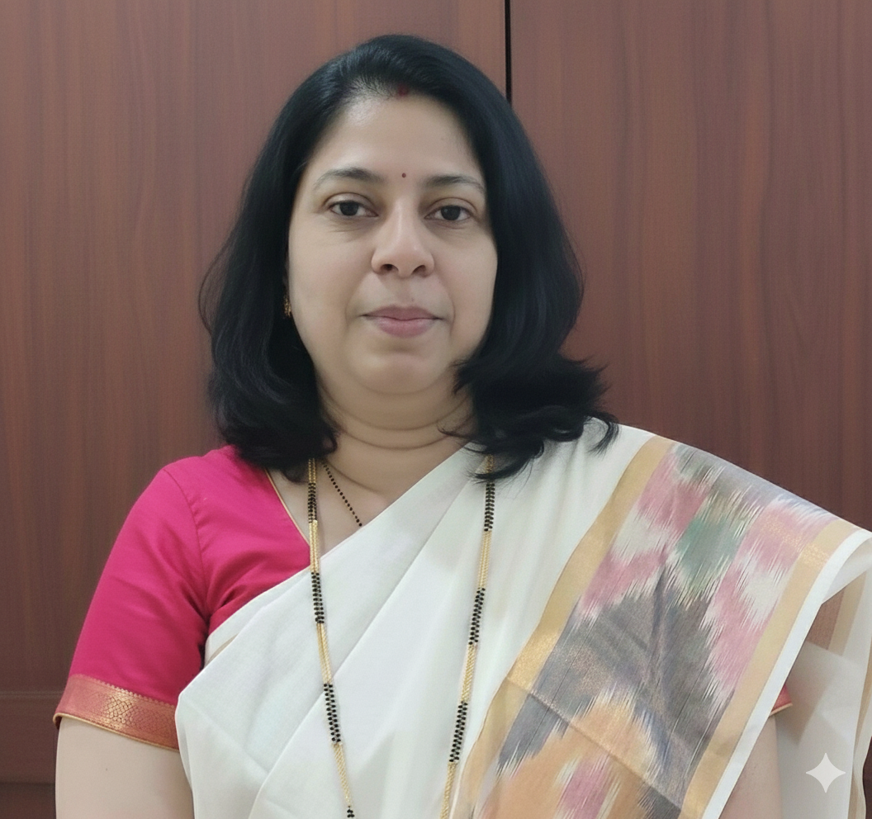
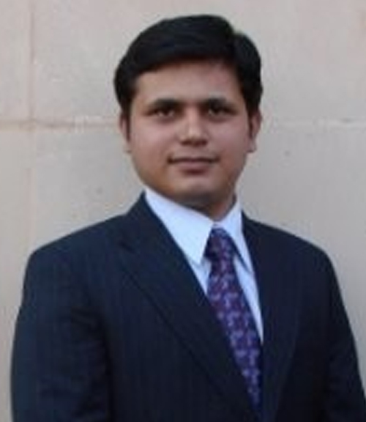
Qutrit Innovations - Team
Swati Mujumdar
Shashikant Gavhane
Founder, Promoter
Co-Founder, Director
Email : qutritinnovations@gmail.com
Phone : 9920539449

Slide 14

Thank You
Thank you for your valuable time and attention today. We sincerely appreciate your interest in Qutrit Innovations and our vision.
We are eager to discuss any questions you may have, explore potential partnerships, or delve deeper into investment opportunities.
Contact Qutrit Innovations:Email: ​info@qutritinnovations.com​Website: www.qutritinnovations.com
We look forward to the opportunity of collaborating with you to innovate and achieve mutual success.

